Slide 1
University Guidelines on Integrating Generative AI
Ashwini Pednekar, Kiley Jolicoeur, Vedant Murudkar

Slide 2
Research Scope
What can we determine about the state of gAI in American universities from guidelines released on the websites of the top 100 American universities ranked by US News & World Report?

Slide 3
Data Collection
Produced a list of the top 100 ranked universities from US News & World Report (list contained 104 total)
Used the OpenRefine to pull data from the Wikidata API to create contextual data about the universities (Carnegie ranking, size, location, website URL)
Manually searched for and collected universities’ guidelines, compiled into spreadsheet

Slide 4
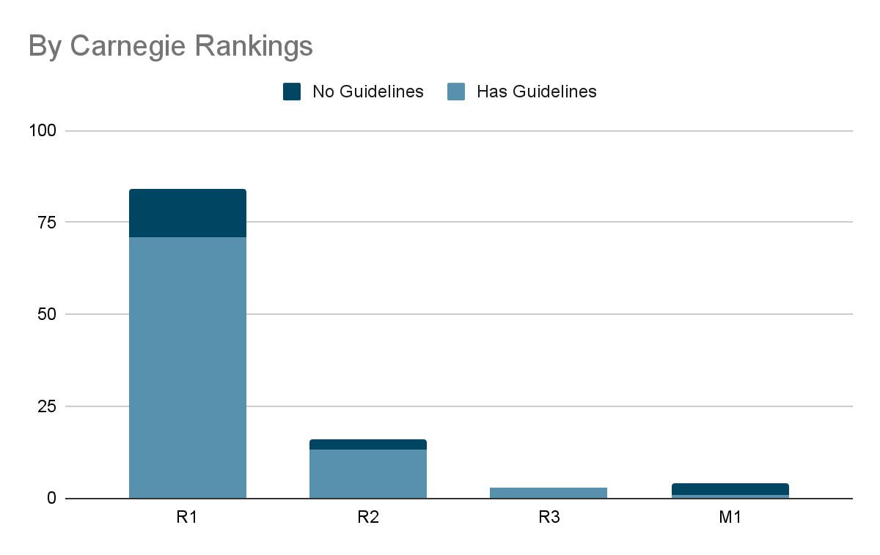
Universities

Slide 5
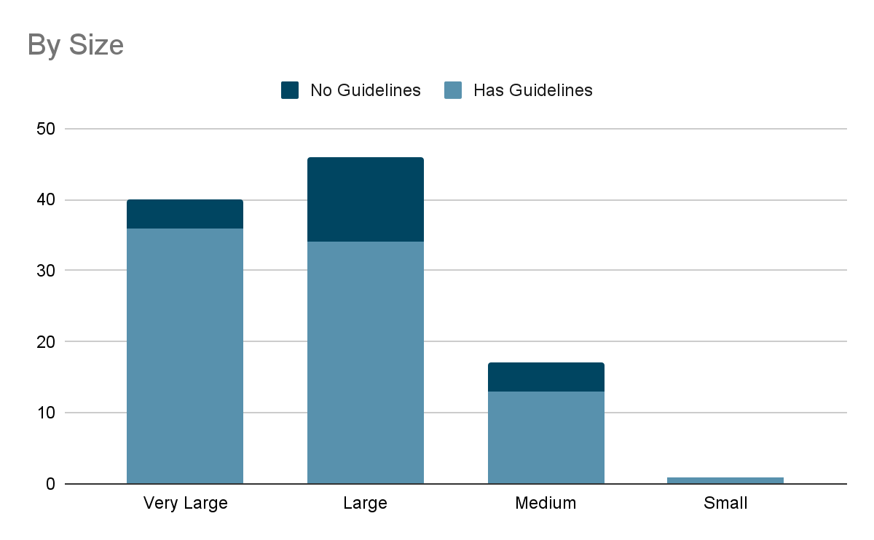
Universities

Slide 6
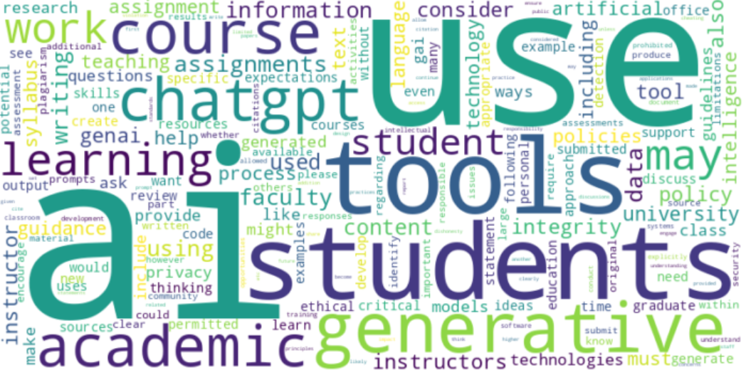
Corpus Linguistics
Unigram frequency

Slide 7
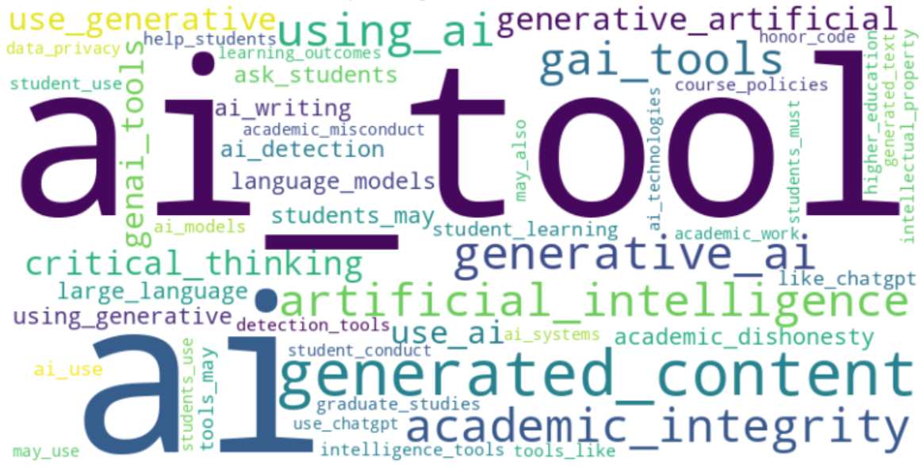
Corpus Linguistics
Bigram frequency

Slide 8
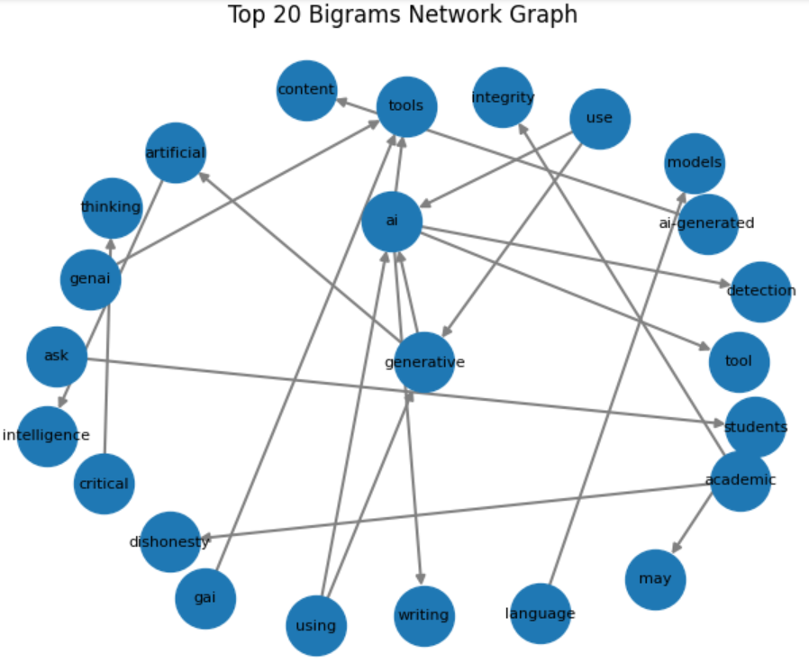
Corpus Linguistics
Bigram Network

Slide 9
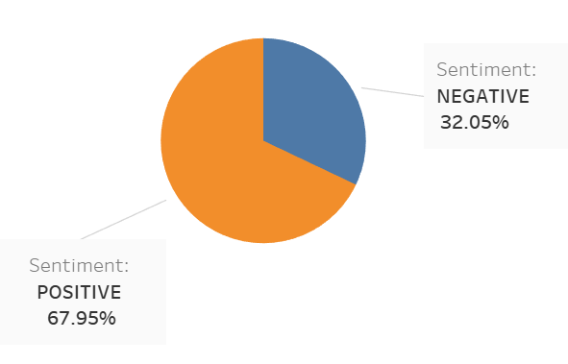
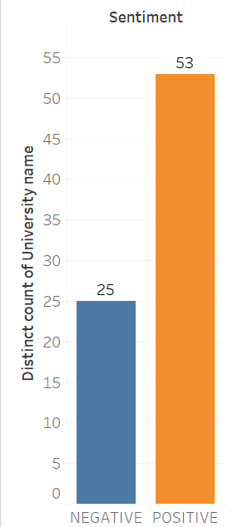
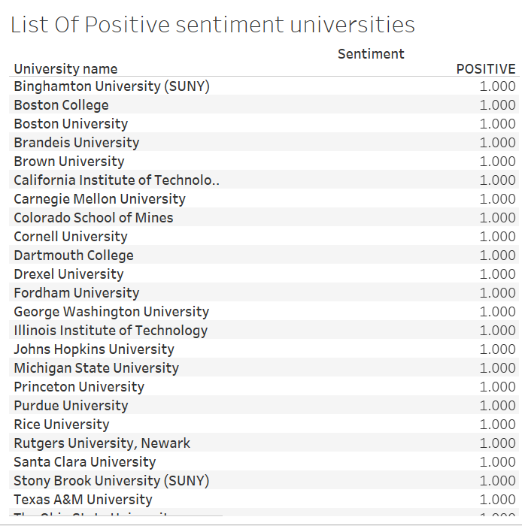
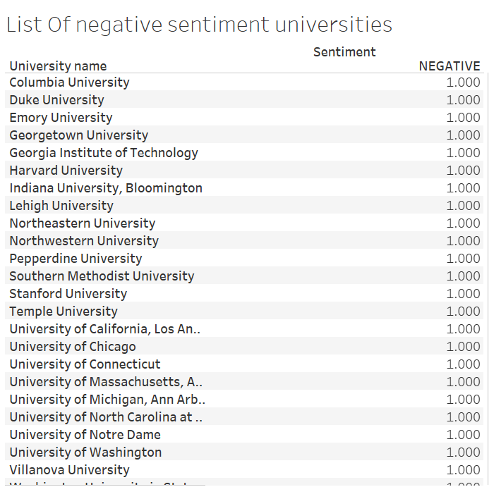
Sentiment Analysis
Default distilbert-base-uncased-finetuned model
Using Hugging Face

Slide 10
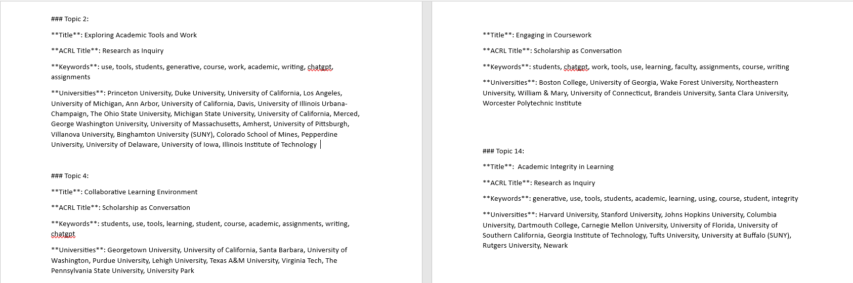
Common Topics
Using LDA

Slide 11
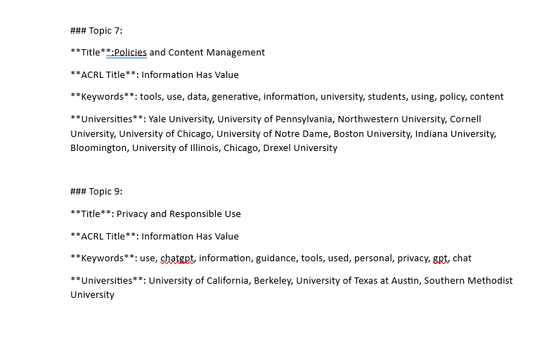
Common Topics
Using LDA
More topics are available at:
https://docs.google.com/document/d/1bpYcH5ftr4dlZHfv-L-XdXR4v6PHLKEB/edit?usp=sharing&ouid=109044528548783540777&rtpof=true&sd=true

Slide 12
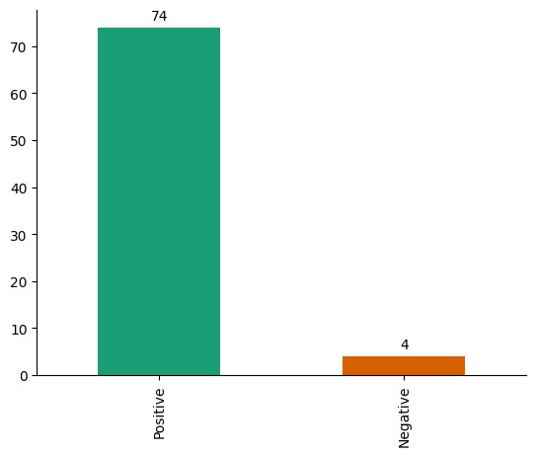
Sentiment Analysis
Using VADAR
Universities with Negative Output
University of Pennsylvania
University of North Carolina at Chapel Hill
University of Florida
Worcester Polytechnic Institute
Notes:
VADER is a lexicon and rule-based sentiment analysis tool
VADER is successfully able to predict positive sentiments with respect to ethics, collaborations, privacy measures , innovation
However it is so far able to just predict just Four universities with negative stance on the topic
It is interesting to note that University of North Carolina at Chapel Hill and Worcester Polytechnic Institute have come out be common with the results of hugging face sentiment analysis

Slide 13
Results : Hugging Face V/S Vadar
Hugging Face model offers higher accuracy in capturing nuanced sentiments
VADER is straightforward to use and doesn't require fine-tuning, making it suitable for quick sentiment analysis tasks although in this case we need more understanding of terms
VADER comes with a pre-built lexicon that contains words with polarity scores. It can handle sentiment in the context of negations, booster words, and emoticons.
In conclusion Hugging face gives a better division based on sentiment analysis
Notes:
Comparing the results we can conclude that hugging face gives a better division based on Sentiments indicated in the text
This could be due to the basic functioning of both Hugging face and vadar model
Vadar being a lexicon, rule based can provide a preliminary understanding of text plainly based on the polarity scores of the words
On the other hand Hugging face model which requires fine tuning the pre-trained model on a dataset specific to your domain or task. Fine-tuning allows the model to adapt to the nuances of your data.

Slide 14
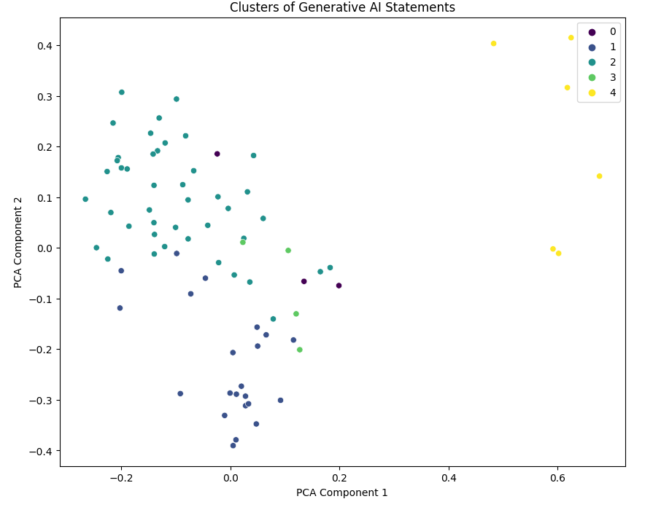
Clustering
K-means
Cluster 1: "Ethics-Centric Policies"
Universities focusing heavily on ethical considerations.
Cluster 2: "Research-Driven Policies"
Universities emphasizing research guidelines and collaborations.
Cluster 3: "Comprehensive Policies"
Universities with well-rounded and comprehensive AI policies.
Cluster 4: "Privacy-Focused Policies"
Universities prioritizing data privacy in their AI policies.
Cluster 5 : Prohibition and restrictive policies
Universities focusing on discouraging the use
Notes:
K-means efficiently categorizes universities based on the predominant themes in their AI policies.
It also provides insights for tailoring AI policies to align with ethical, research, comprehensive, privacy, or restrictive themes.
K-means clustering offers a holistic view of AI policy landscapes among top universities.
It is interesting to note that group 4 which is the cluster coloured in yellow representing the group of universities that have restrictive AI policies is separated from the rest.
So based on this scatter plot we can successfully differentiate between positive and negative stance on the topic

Slide 15
Literacy Models
What’s missing in current scholarship on the use of gAI?
AI Literacy
Data
Literacy
Digital Literacy

Slide 16
Literacy Models
Information Literacy!
AI Literacy
Data
Literacy
Digital Literacy

Slide 17
Kulthau’s Information Search Practice
Generative AI can be used as a tool for this!
And this!
And this!
And this!
And this!
And this!
Notes:
https://wp.comminfo.rutgers.edu/ckuhlthau/information-search-process/

